Slide 2
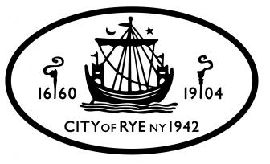
THANK YOU
FOR BEING A MEMBER OF SUSTAINABLE WESTCHESTER!

Slide 3
Who We Are
Non-profit membership organization, consisting of 42 out of the 45 municipalities in Westchester, plus the County itself.
The City of Rye is a member of Sustainable Westchester and, by extension, so are each of you.
Notes:
As members of Sustainable Westchester, you are entitled to benefit from and to participate in the programs created in collaboration with your town’s leaders.

Slide 4
What We Do
Work with and on behalf of our member communities to promote sustainability initiatives.
Assist and empower communities to navigate toward a sustainable future.
Share tools, resources and incentives for healthy, vibrant and attractive neighborhoods.
Notes:
We listen to the needs and wishes of those living and working in our member communities. We create programs to help achieve your goals for the highest quality of life possible

Slide 5
Focus Areas
Energy
Transportation & Land Use
Waste Reduction/Recycling
Water
Food
Notes:
This is a glimpse of our current focus areas. We’ll be talking about Energy tonight, The subject of our presentation is: How to Read your Con Ed bill and we will help you decipher the charts and language Con Ed uses on its bills.

Slide 6
Westchester Power A Program of Sustainable Westchester CCA
Community Choice Aggregation (CCA) is basically a bulk buying program for electricity supply
Aims to provide competitive electricity rates
Leverages the purchasing power of 20 munis (+/-100,000 households)
Promotes use of renewable energy and local jobs
14 communities opted for 100% green supply

Slide 7
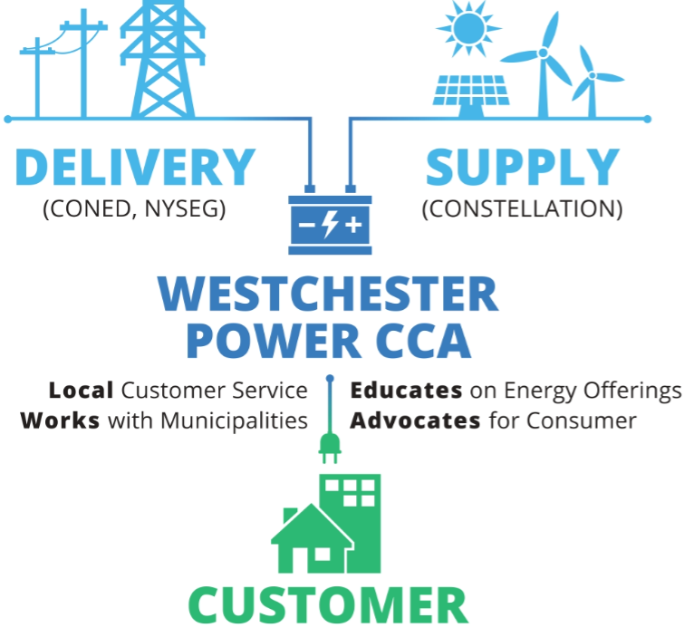
How WP’s CCA Works

Slide 8
WP Program Benefits
Reliable vetted program
Competitive rates for residents and small businesses
Stable, fixed rates--lower than previous 12-month average
Affordable renewable energy option
Local presence, dedicated staff--offices in Mount Kisco
Advocates for local communities and account holders
Community outreach
Paves the way for truly sustainable future

Slide 9
Neighbors in the Program
Bedford (Bedford Village, Katonah & Bedford Hills)
Greenburgh
Hastings-on-Hudson
Irvington
Larchmont
Lewisboro
Mamaroneck (Town & Village)
Mount Kisco
New Castle (Chappaqua & Millwood)
New Rochelle
North Salem
Ossining (Town & Village)
Pelham
Pleasantville
Rye Brook
Somers
Tarrytown
White Plains
And others currently in pre-launch
Notes:
Many of your neighbors in are already in the Westchester Power CCA

Slide 10
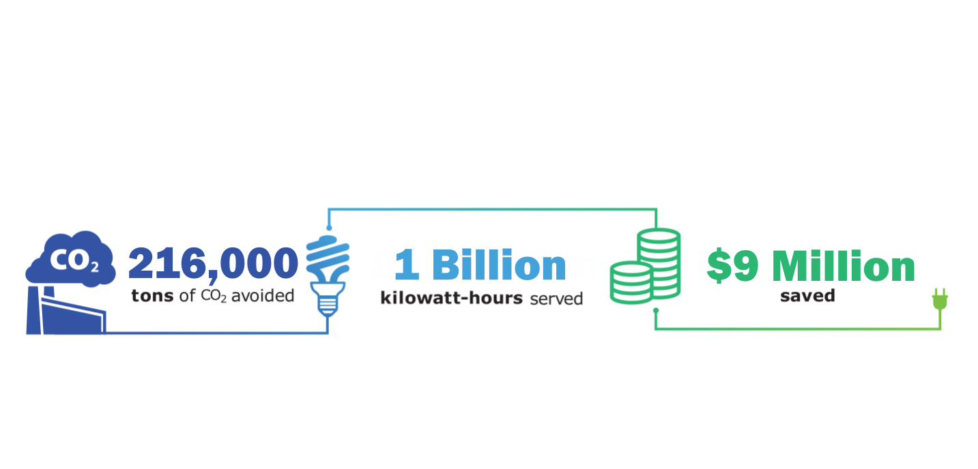
By the Numbers
Notes:
These numbers - since program launch in April of 2016

Slide 11
Supply Mix Options
(Coal, Oil, Gas, Nuclear, Other)
(Currently 100% Wind)

Slide 12
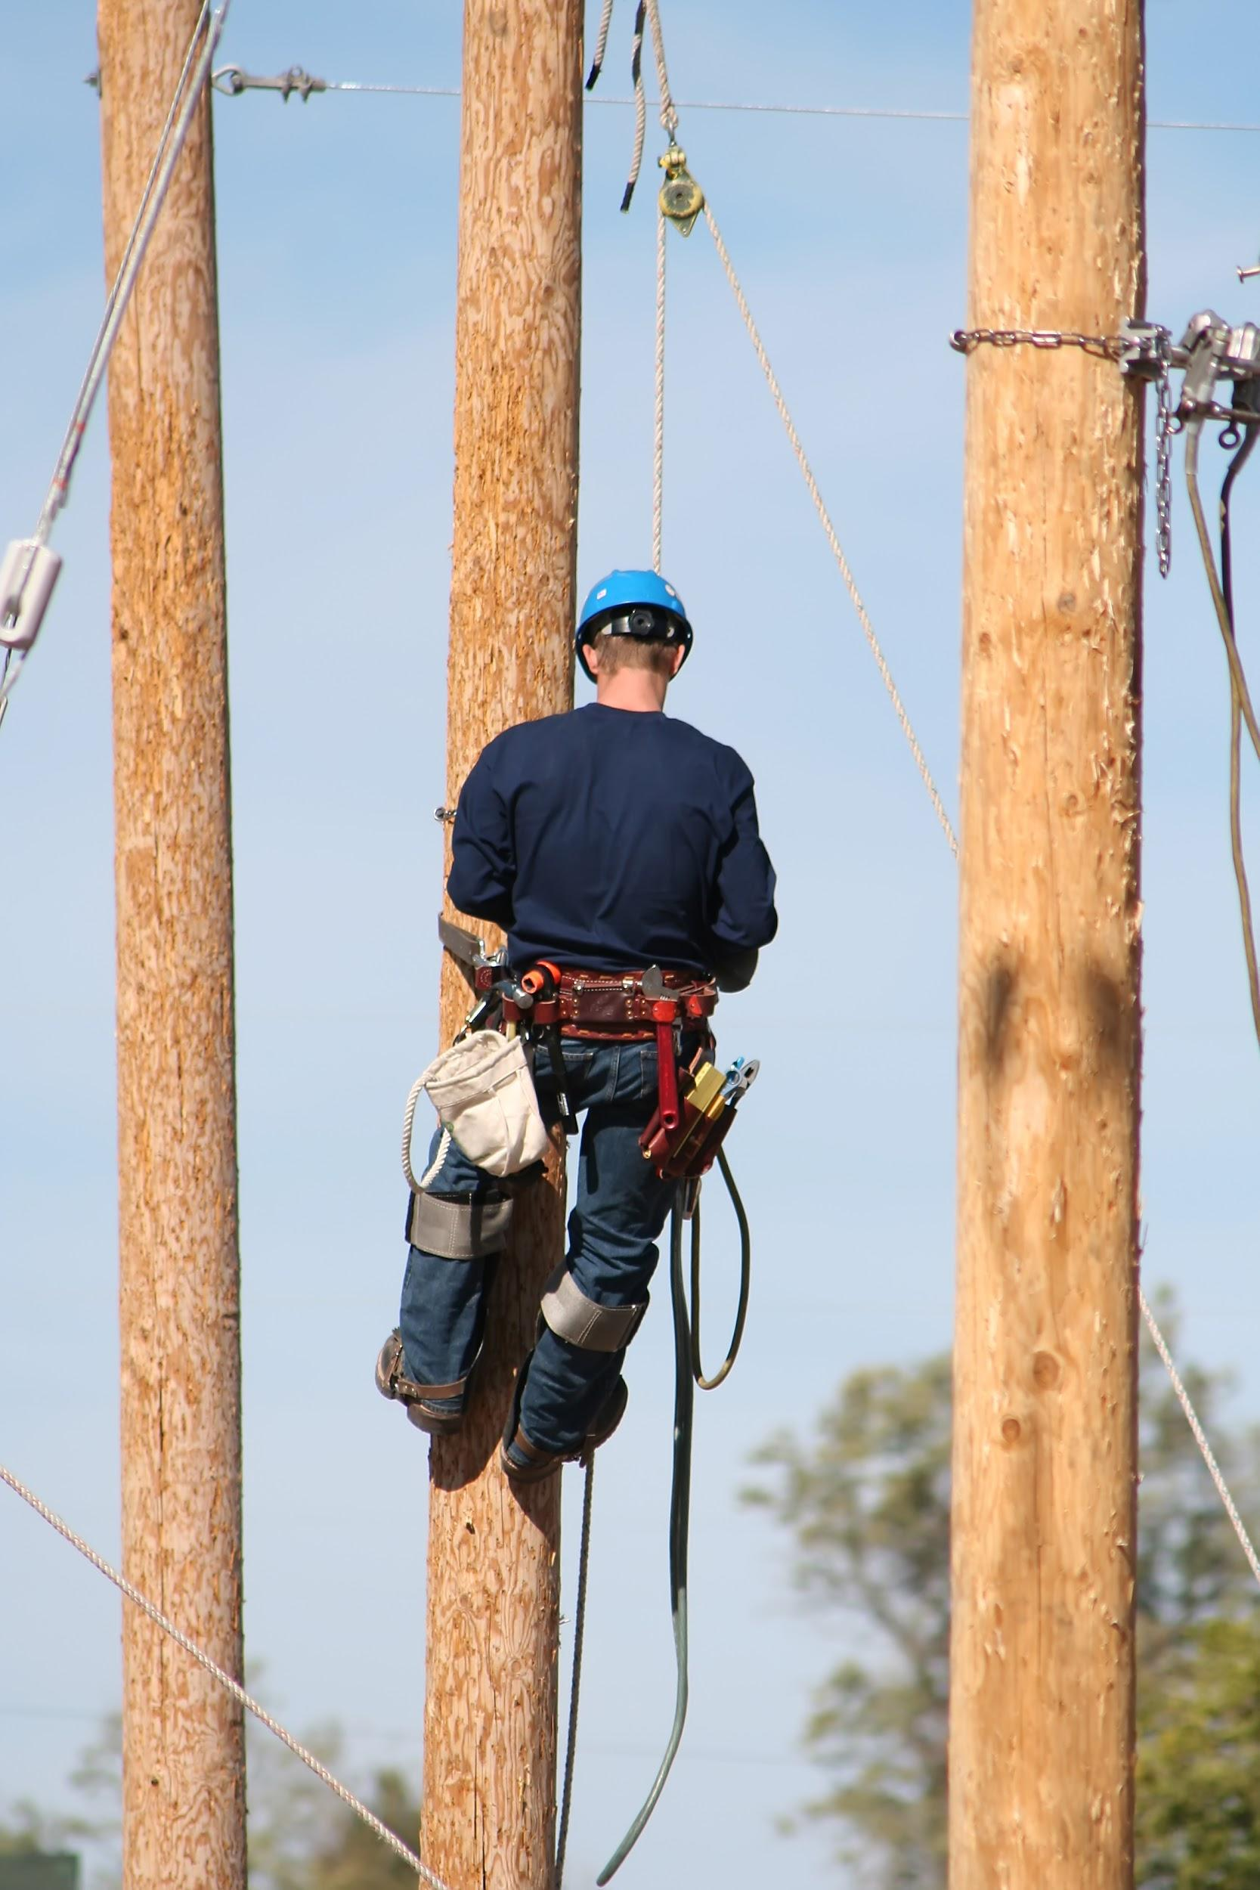
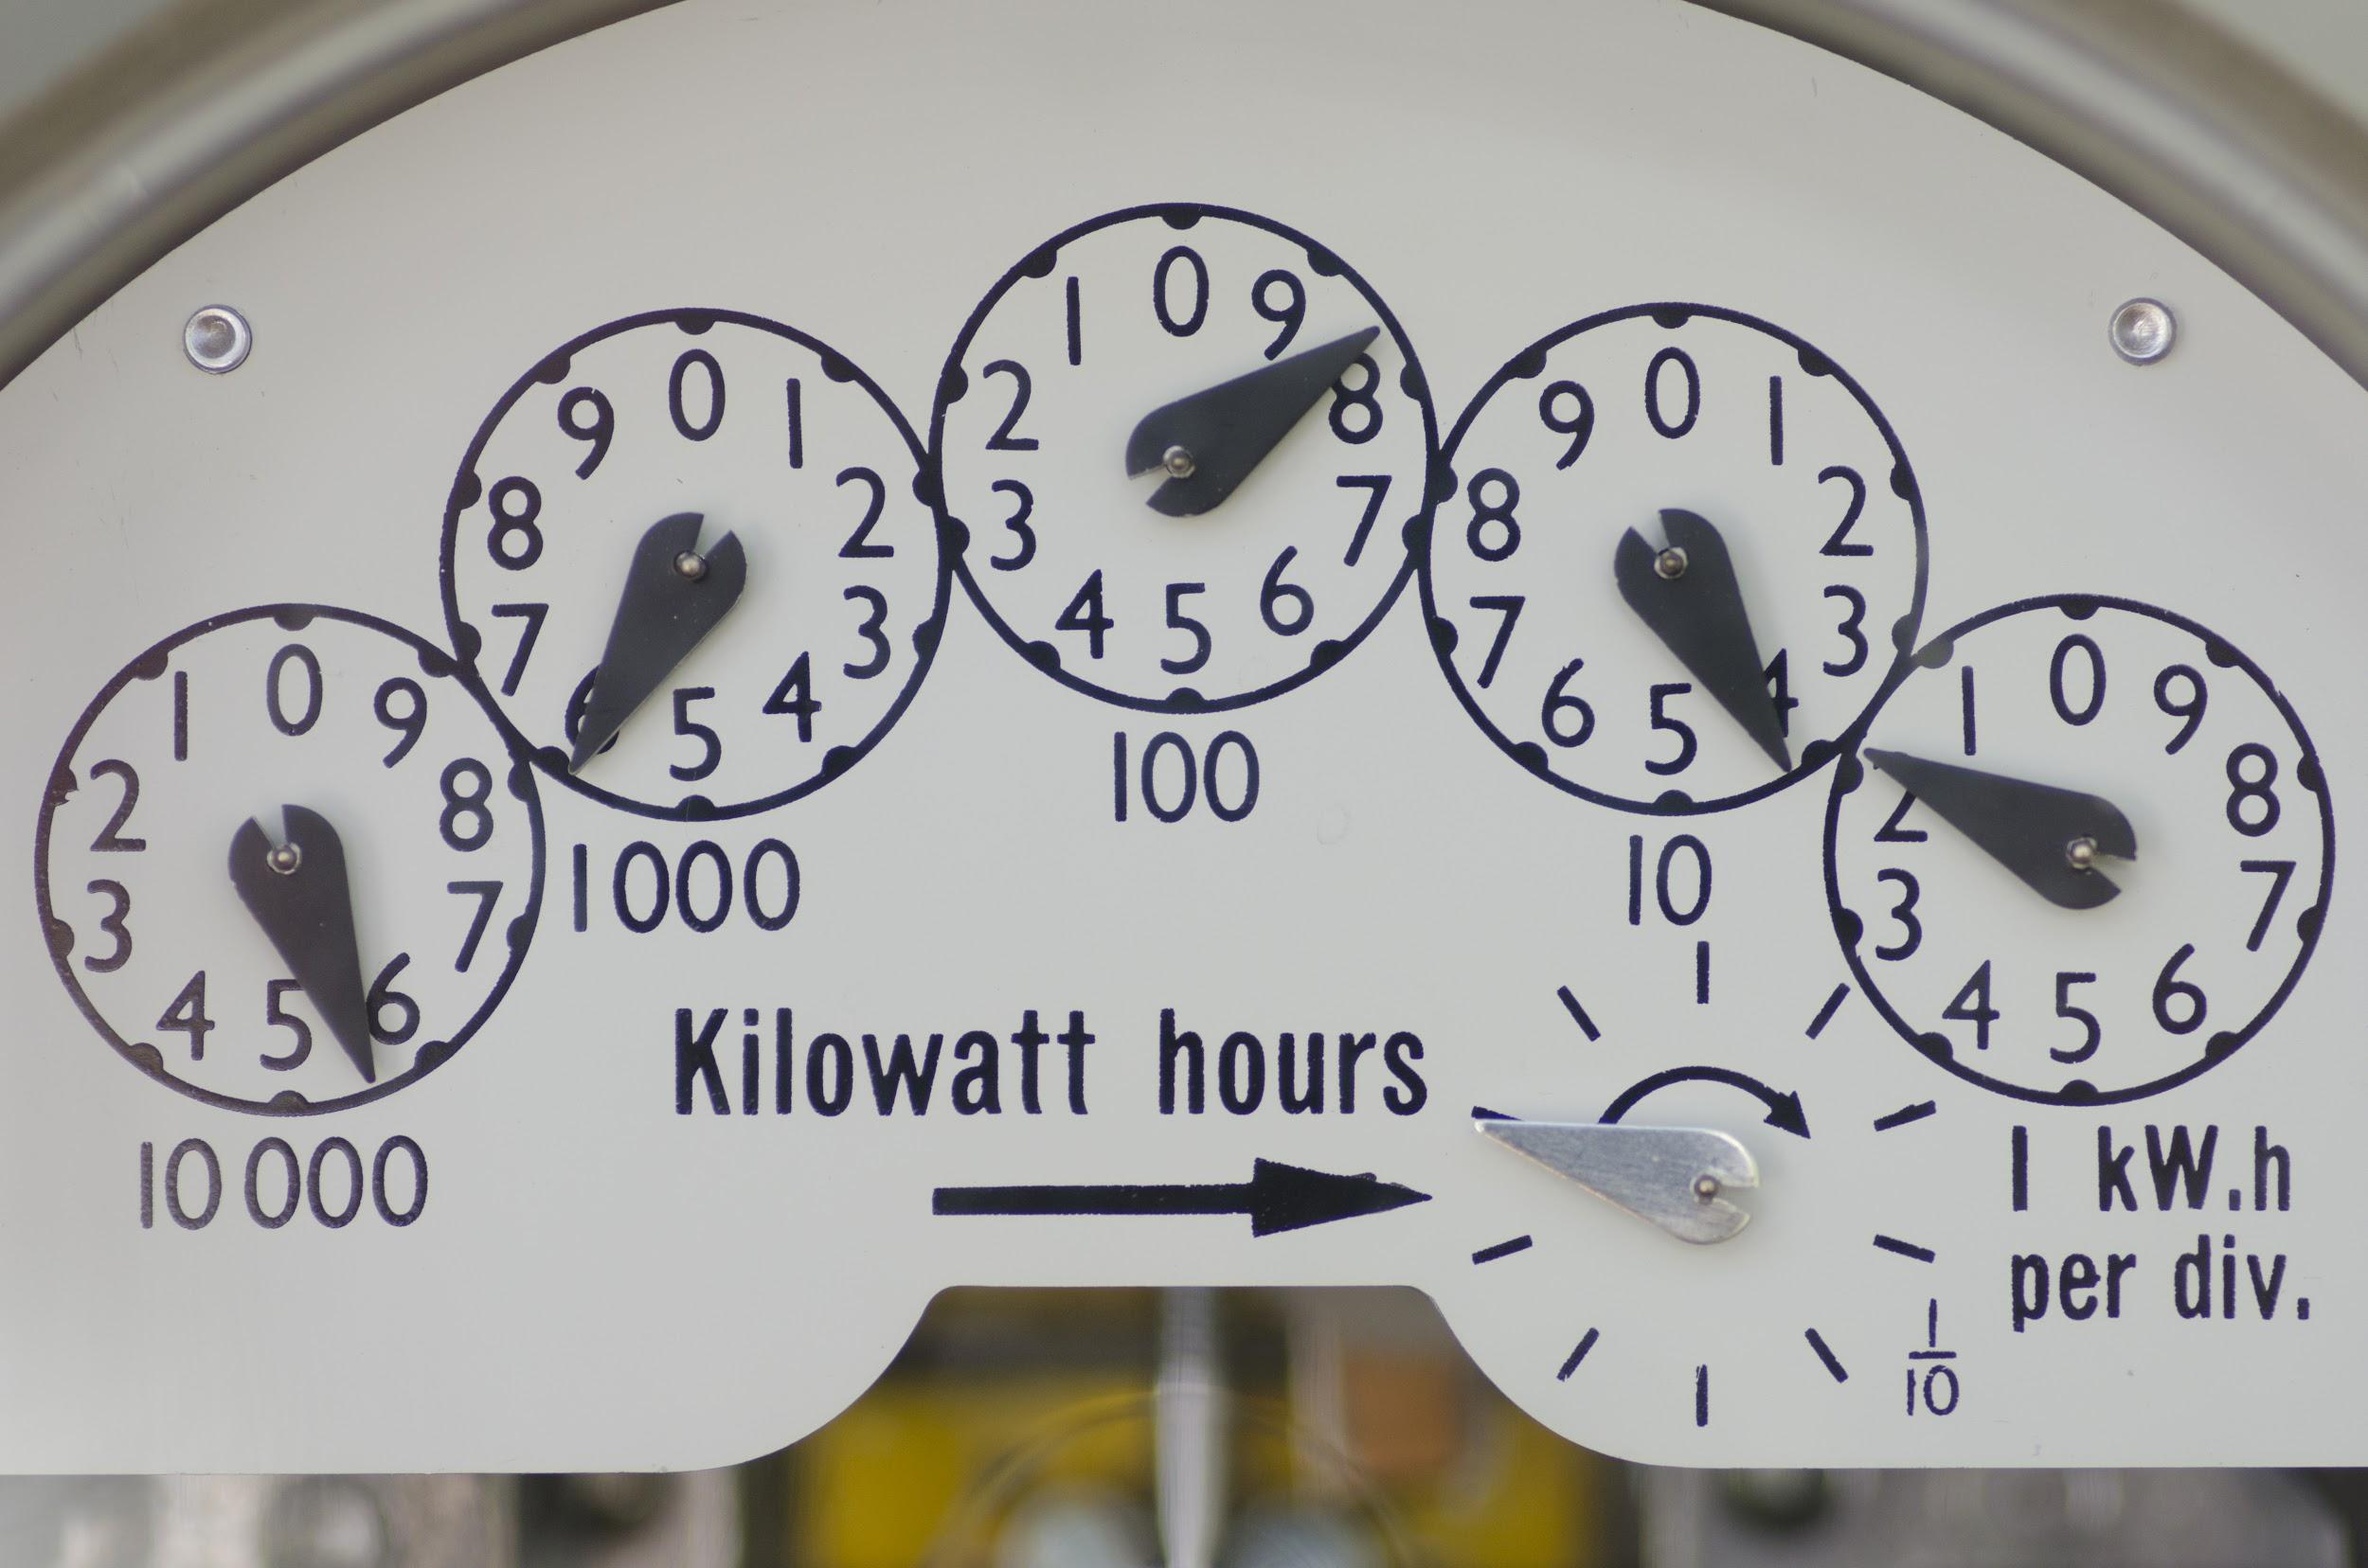
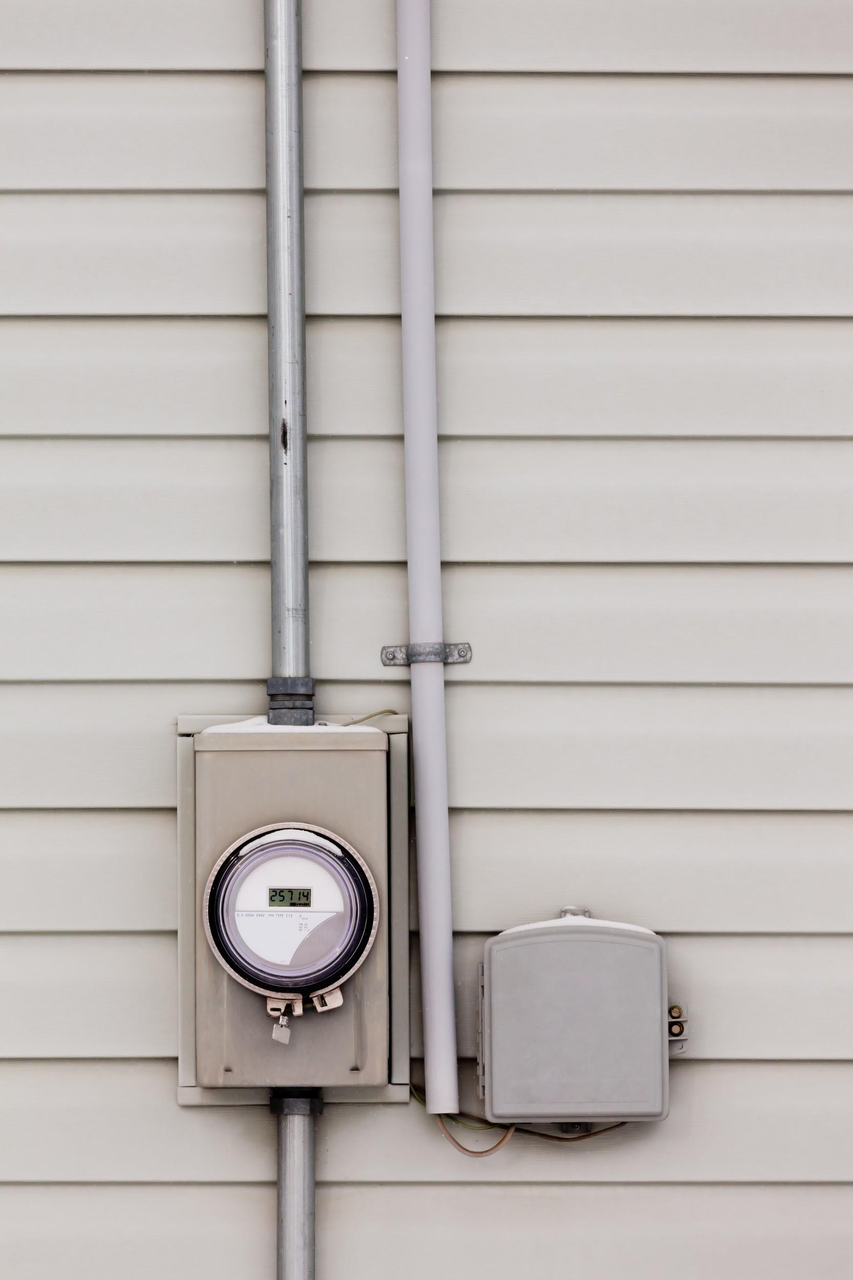
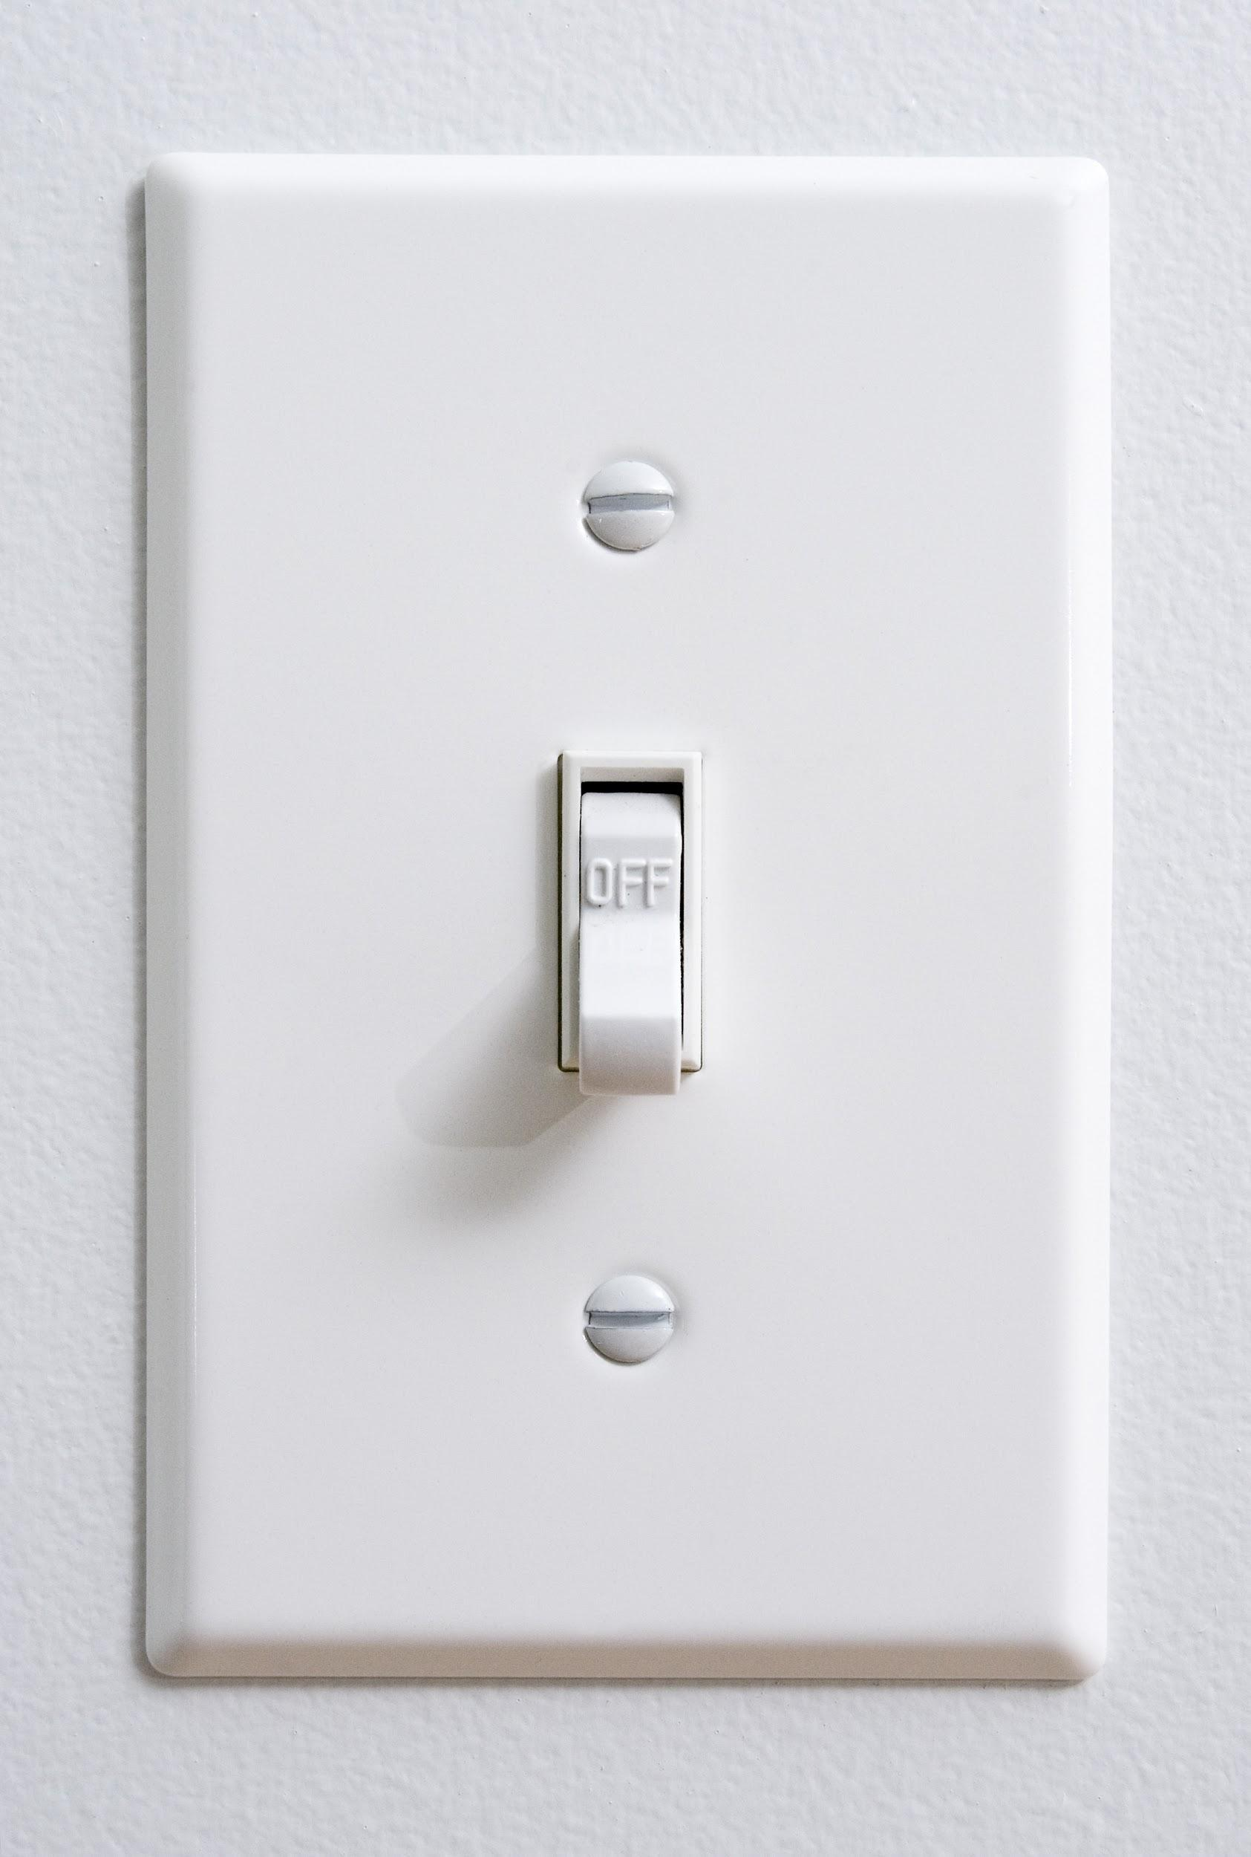
How to Read Your Bill
Con Edison Westchester Power Utility Charges Constellation
Delivery and Electric Supply
Notes:
There are always two parts to an electric bill - the Delivery and the Supply. Con Edison provides you with a monthly, unified bill for both. Who is paying for the generation / buying electricity

Slide 13
Thank you!
Jenna Amundsen
Virginia Steinberg
914-242-4725
www.sustainablewestchester.org
Notes:
Thanks to those in attendance, Rye Sustainability Committee and to the Rye Free Library for providing their lovely space

